Slide 1
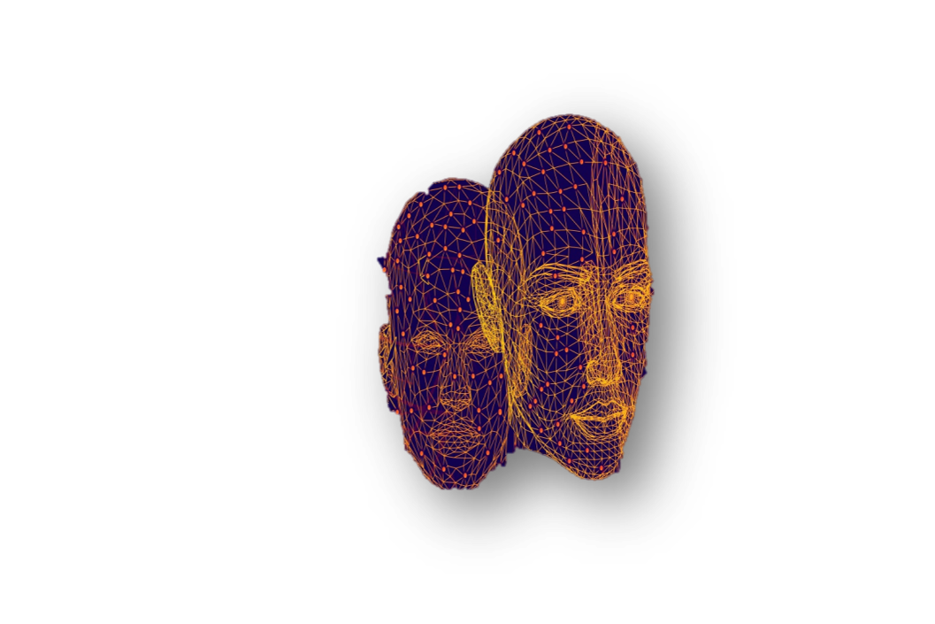
Control Statements-Guided Projects (CSC 101)
B.Sc. Computer Science

Slide 2

Project I
One of the key issue that have threatened organizations and institutions is that of name verification. To solve it, people now use biometric softwares and machine vision enabled tools to verify identities of their employees and take attendance. Mrs. Jane runs a delivery business with 15 employees, but she would want a way to identify if a user is one of her employees. Your mission, should you choose to accept it (…see mission impossible), is to write a program that takes a user's name and check if he/she exists in the list of 15 employees, if they do…you welcome them appropriately….otherwise, you politely tell them to Get Out ☺.

Slide 3
Project II
You run a delivery service, and charge people based on their location and weight of their package. The following are some of the things you consider.
You charge #2000, whenever you are delivering a package with weight of 10kg and above to PAU, and #1500 when it is less.
However, you charge #5000 whenever you deliver to Epe, a package with weight of 10kg and above, and #4000 when it is less.
Write a program that tells a user how much to pay, based on their location, and package weight.

Slide 4
Project III
Before an individual is admitted into Computer Science, he/she must:
Score 230 or above in jamb
Have at least 5 credit in the 5 key subjects(You know them)
Pass and interview.
Your mission, should you choose to accept it, is to automate this process, by writing a program that tells a particular candidate if he/she is admitted into computer science, based on their inputs.

Slide 5
Project IV
Congratulations for making it this far…But we want more.
What other problem can you think of, which you can solve using what you have learnt so far?
Write the codes for it and let's see ☺

Slide 6


